Slide 1

Olessia Bauer
July 2, 2026

Slide 2


Cora Liu (SCA) meeting, June 22
Olessia.bauer.cec28@gmail.com
Reminder:
M.S. 217 has a T-building. It is over 20 years old. It must be replaced with an annex.
Cora Liu stated:
There is not enough land to build an annex.
It will take 10 years to build and the city parks will not give up the land.
Follow-up with Cora Liu:
1. A request to provide a feasibility study to start the land alienation procedure have not been answered.

Slide 3
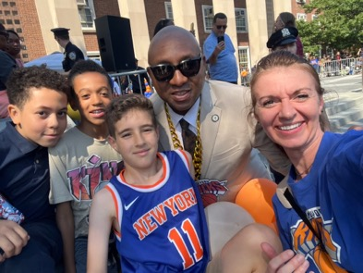
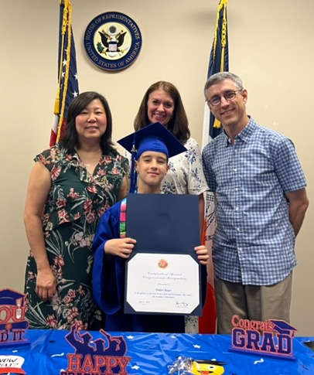
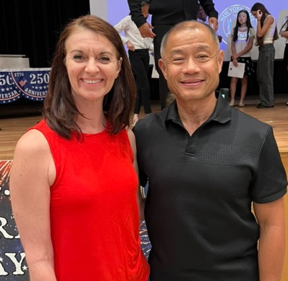
Meetings with politicians, June 25, 27,28
Olessia.bauer.cec28@gmail.com

Slide 4
Council member Gennaro meeting,
July 1st (Henry Yam, Chief of Staff)
Olessia.bauer.cec28@gmail.com
City parks and M.S. 217 are located on the city land – the land can be shared.
The school must be compliant with the state law of small classroom sizes.
$40 million might be needed to build an annex
Henry Yam: ”I'll be conducting my own outreach on this and we'll see what we can do”.
Stakeholder meeting will be scheduled to discuss the annex and collaborative partnership to protect natural community assets, upgrade existing green space infrastructure, and build a sustainable model for the school and the surrounding neighborhood

Slide 5
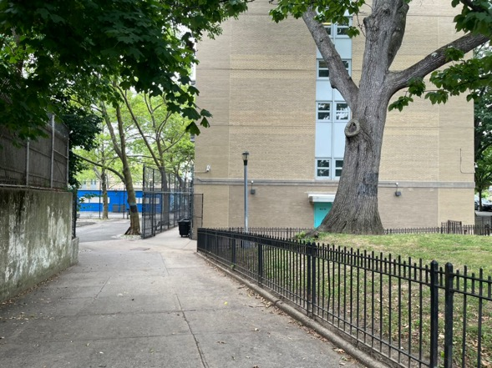
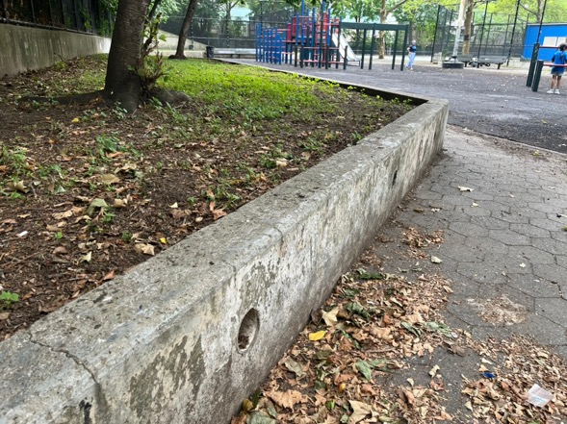
M.S. 217
Olessia.bauer.cec28@gmail.com
City Parks and T-building

Slide 6
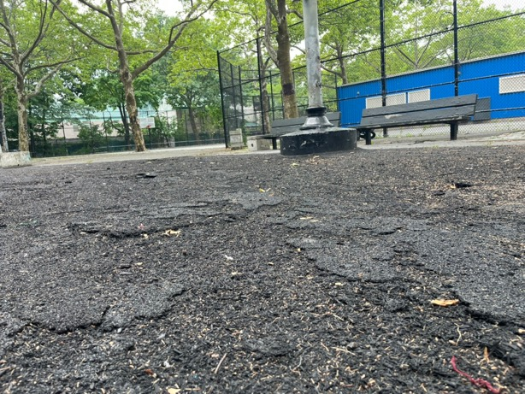
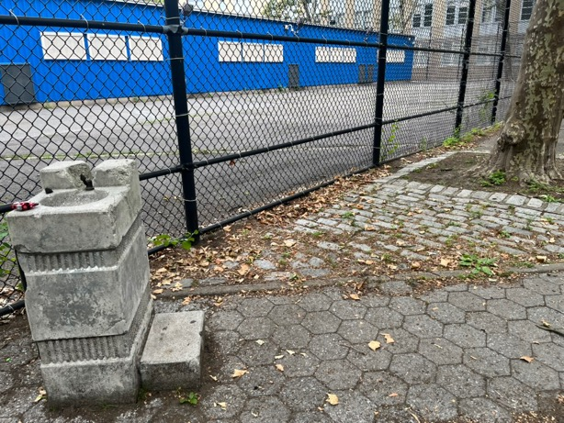
M.S. 217
Olessia.bauer.cec28@gmail.com
City Parks and T-buildng
1
4

Slide 7
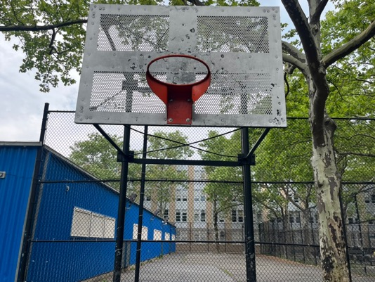
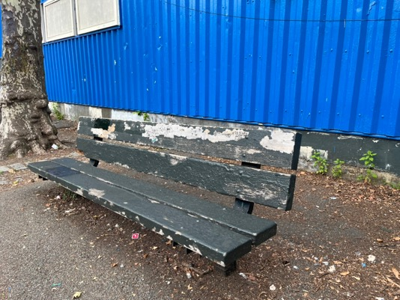
M.S. 217
Olessia.bauer.cec28@gmail.com
City Parks and T-building

Slide 8
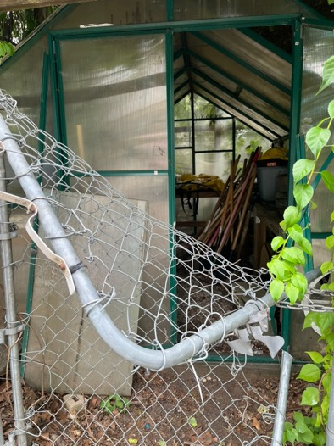
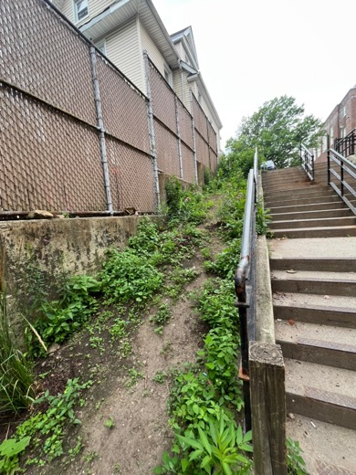
M.S. 217
Olessia.bauer.cec28@gmail.com
City Parks and T-building

Slide 9
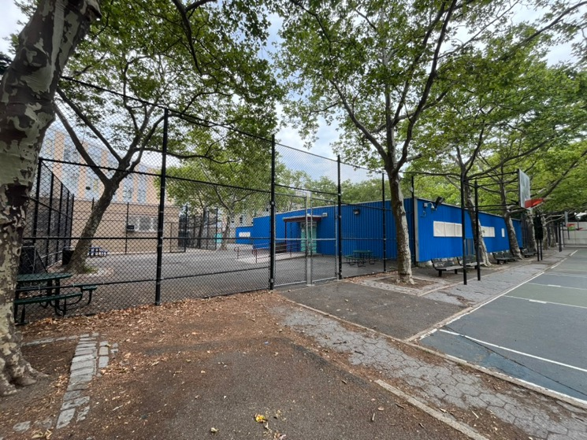
M.S. 217
Olessia.bauer.cec28@gmail.com
City Parks and T-building

Slide 10
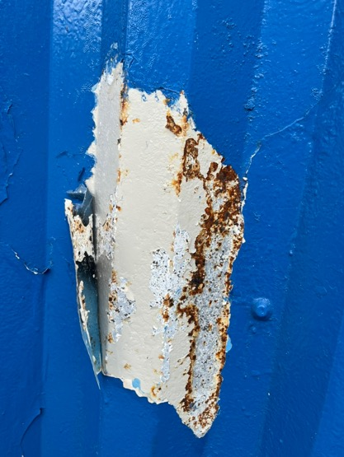
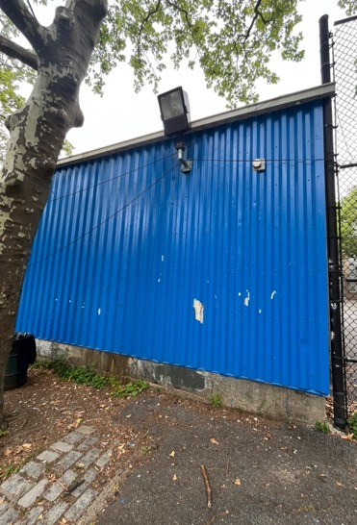
M.S. 217
Olessia.bauer.cec28@gmail.com
City Parks and T-building

Slide 11

Olessia.bauer.cec28@gmail.com
No updates

Slide 12

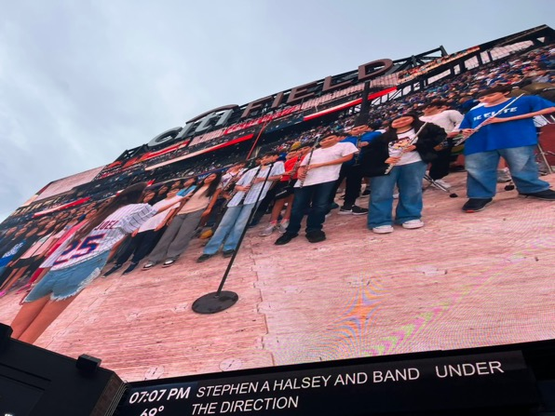
J.H.S 157
Olessia.bauer.cec28@gamil.com

